Slide 1
Downloading and Installing the Cloudera VM Instructions (Windows)

Slide 2
Software needed
1. Download VirtualBox. Goto
https://www.virtualbox.org/wiki/Downloads
2. Download the Cloudera VM. Go to
https://downloads.cloudera.com/demo_vm/virtualbox/cloudera-quickstart-vm-5.4.2-0-virtualbox.zip

Slide 3
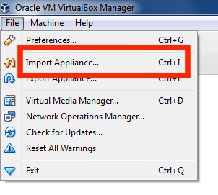
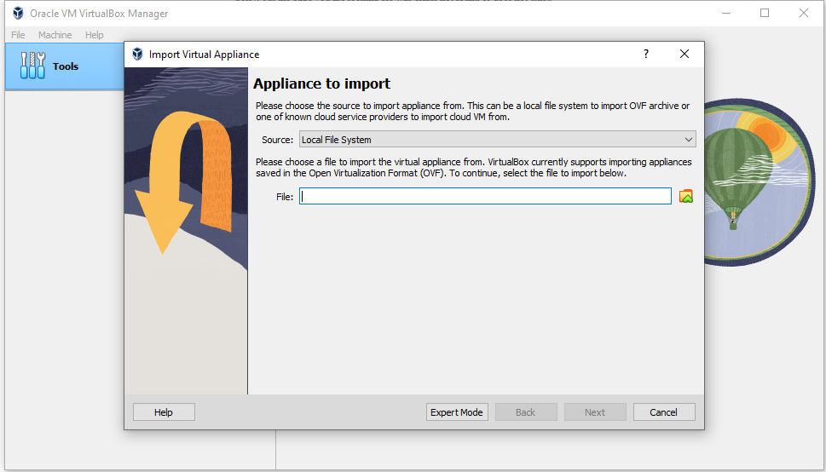
Installation Steps
Install VirtualBox
Unzip the Cloudera VM:
Start VirtualBox.
Begin importing. Import the VM by going to File -> Import Appliance
5
5. Click the Folder icon.

Slide 4
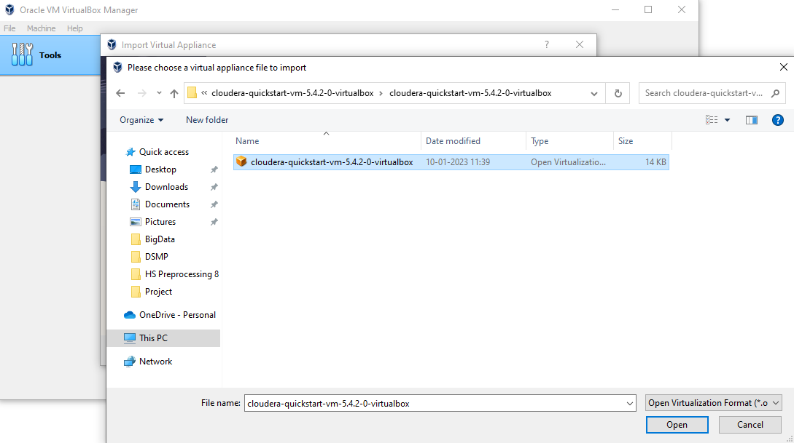
Installation Steps
6. Select the cloudera-quickstart-vm-5.4.2-0-virtualbox.ovf from the Folder where you
unzipped the VirtualBox VM and click Open

Slide 5
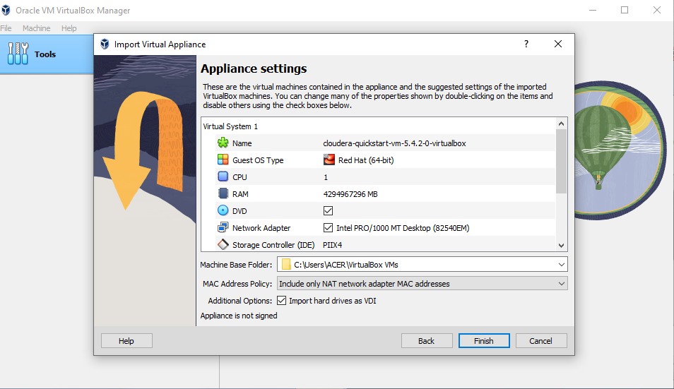
Installation Steps
7.

Slide 6
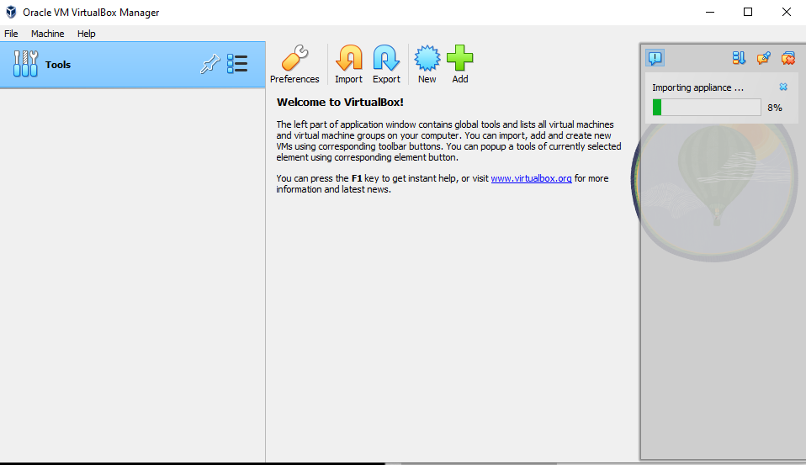
8.

Slide 7
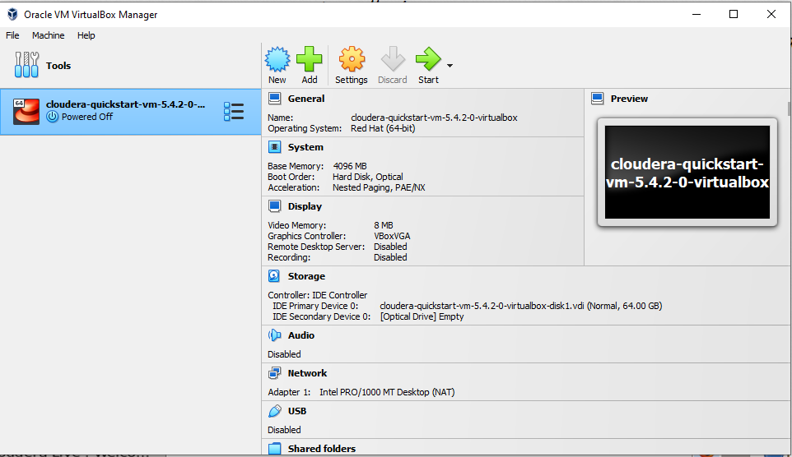
Installation Steps
9.

Slide 8
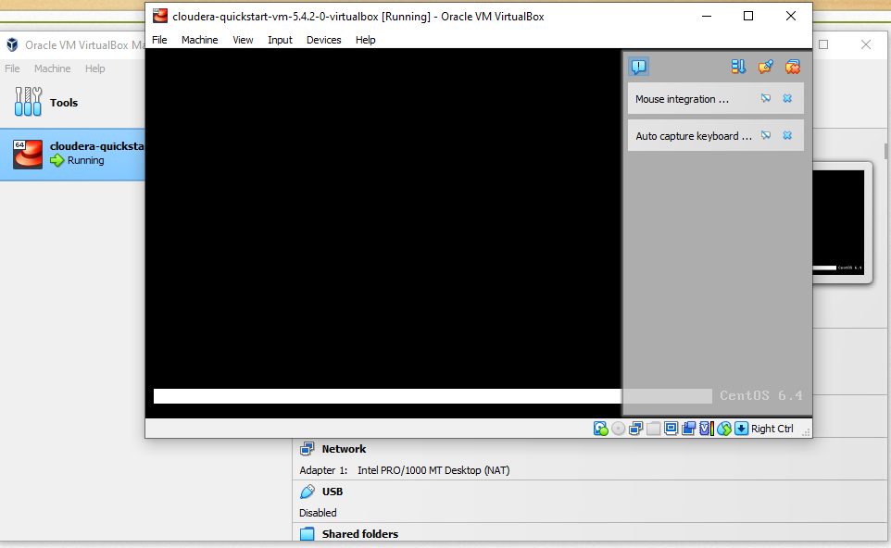
10.
It will take some time to bootup. So keep patience

Slide 9
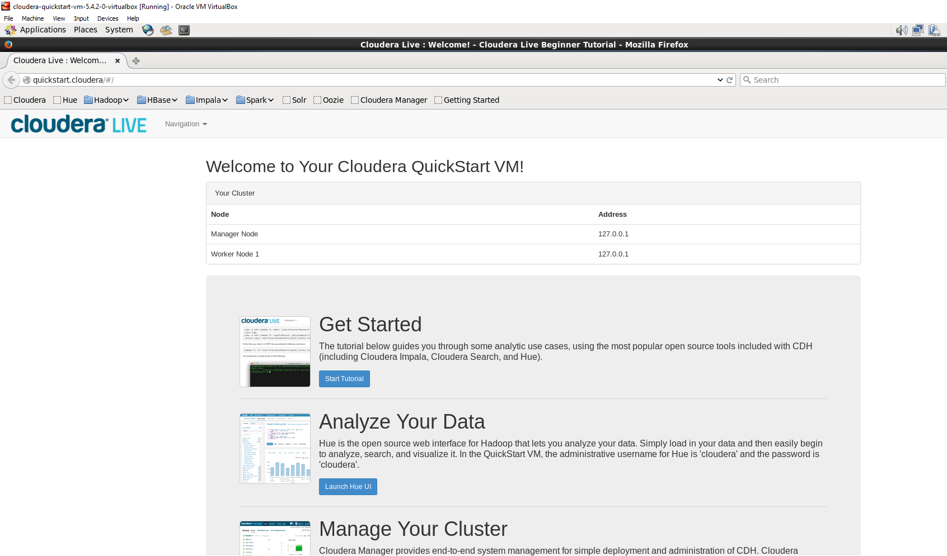
Installation Steps
11. The Cloudera VM desktop. Once the booting process is complete, the desktop will
appear with a browser

Slide 10
Installation Done

